Slide 1

Santander Customer Satisfaction
Which customers are happy customers?
Created By
T Jitendra Kumar
Mentors
Netali Agrawal
Yogesh Kothiya
Ashu Prasad
Ankit Kumar Bhagat

Slide 2
Why?
There are few points why do we need to do the predictive analysis:
Customer Satisfaction is the key measure of success.
Unhappy customers generally leave the service provider in very less time after taking subscription.
The important thing is, Unhappy customers rarely voice their dissatisfaction before leaving.

Slide 3
To be done:
Total 370 unique features are provided to every customer in the bank.
There are 72026 number of customers and their data is given for model building.
We need to analyze the data and make it feasible.
We have to build a suitable machine learning model so that Santander Bank can predict the unhappy customers early in their relationship.

Slide 4
Steps:
EDA (Exploratory Data Analysis)
PCA (Principal Component Analysis)
Model Building
Performance Analysis of Every Model
Model Comparison
Final Model Selection

Slide 5
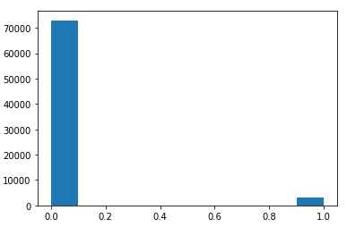
EDA (Exploratory Data Analysis)
The main challenge in this problem: The dataset is huge, it contains abstract features and also it is imbalanced.
Here what I have done for EDA:
Removed features having only “0”s.
Removed duplicate features.
Removed highly correlated features.
A main thing that we learnt by doing EDA of this Santander dataset is how to deal with large dataset and selection of features which are important for model building.

Slide 6
PCA (Principal Component Analysis)
After removing unnecessary columns, we still have a dataset containing more than 100 features/columns. So as to deal with this, we go for PCA.
Here are the benefits that we gained by doing PCA:
Size of dataset became less (Only 7 columns instead of 100+).
Pearson-Correlation got reduced because of orthogonality of principal components after doing PCA.
Model will take relatively less time to train the data.
Here is the variance ratio that we got after PCA:

Slide 7
Model Building
Before building model we have done splitting of the entire data in 7:3 ratio (Train:Test) and after that the built model has been trained with train data and tested over test data. The upcoming slides will show this tested result.
We have used 5 different algorithms for model building:
Logistic Regression
Decision Tree
Random Forest
SVM (Support vector machine)
XGBoost

Slide 8
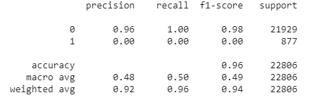
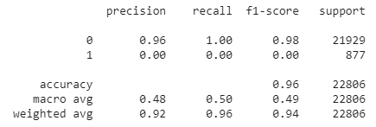
1. Logistic Regression
Before Hyperparameter tuning:
After Hyperparameter tuning:
Here we can observe that even if we have done Hyperparamter tuning, the result still remains unchanged.

Slide 9
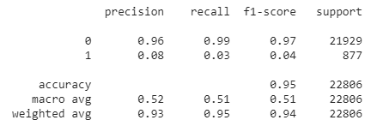
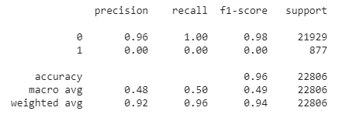
2. Decision Tree
Before Hyperparameter tuning:
After Hyperparameter tuning:
In this case after doing Hyperparamter tuning, the result changed but the change is not that significant.

Slide 10
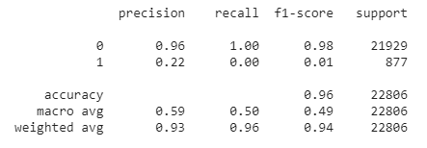
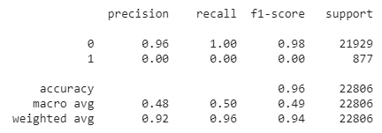
3. Random Forest
Before Hyperparameter tuning:
After Hyperparameter tuning:
In this case also even if we have done Hyperparamter tuning, the result still remains unchanged.

Slide 11
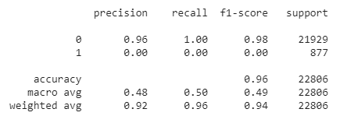
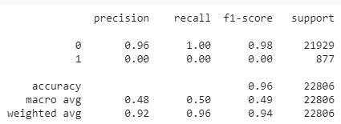
4. SVM (Support vector machine)
Before Hyperparameter tuning:
After Hyperparameter tuning:
In this case also even if we have done Hyperparamter tuning, the result still remains unchanged.

Slide 12
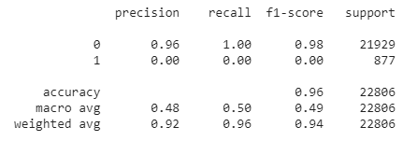
5. XGBoost
For XGBoost algorithm, we have done Hyperparameter tuning first by using RandomizedSearchCV and then built the model using train data. Here is the result of that:

Slide 13
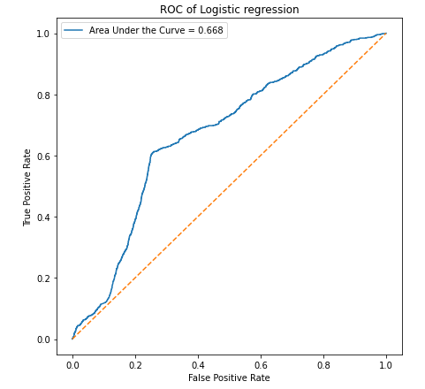
Performance Analysis
Logistic Regression:

Slide 14
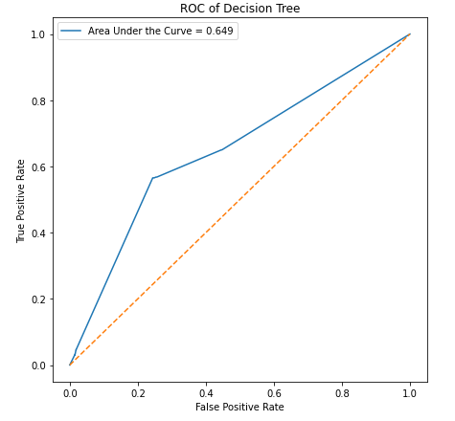
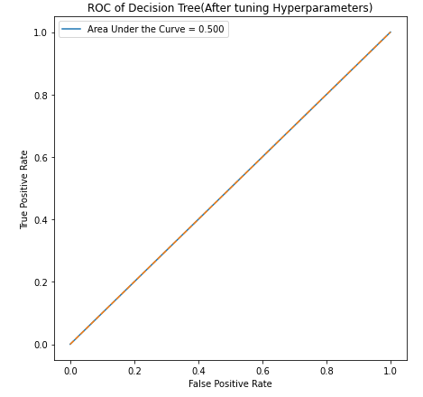
Decision Tree:

Slide 15
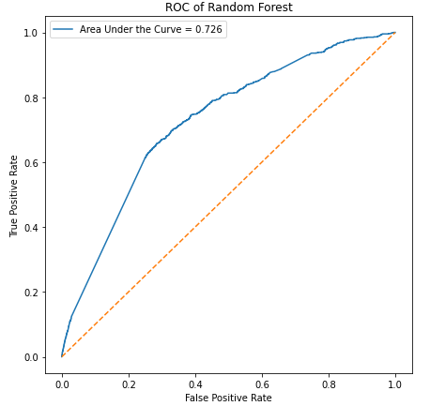
Random Forest:

Slide 16
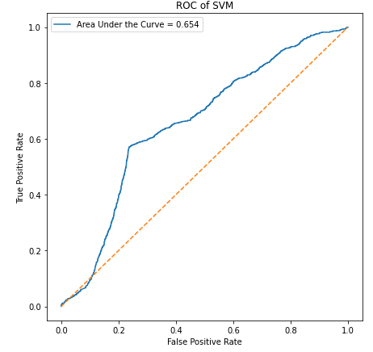
SVM:

Slide 17
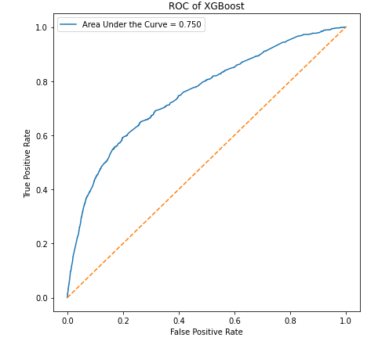
XGBoost:

Slide 18
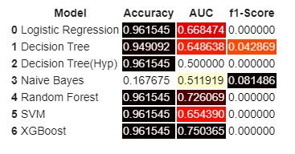
Model Comparison
From all the above models and their results, we have to choose one model for final submission so that it can give the best result among all.
Here is the final model comparison:

Slide 19
Model Selection
From all these analysis and model comparison with RandomizedSearchCV, we have seen that the XGBoost model is performing better than others with accuracy 96% (Approx.) and Area Under the ROC curve is also 0.75 (Approx.).
But for better model performance we should go for GridSearchCV as well.
Link for Code: Code
Code ipynb file:

Slide 20
Bibliography:
https://www.kaggle.com/akshat0007/santander-customer-satisfaction-xgboost?rvi=1
https://www.kaggle.com/cast42/xgboost-with-early-stopping?rvi=1
https://www.kaggle.com/beiwenwu/data-explore-and-visual?rvi=1
https://www.kaggle.com/tks0123456789/data-exploration?rvi=1
https://stackoverflow.com/questions/43036711/scikit-learn-svc-predict-probability-doesnt-work-as-expected
https://machinelearningmastery.com/roc-curves-and-precision-recall-curves-for-classification-in-python/
https://datascience.stackexchange.com/questions/73506/hyper-parameter-tuning-of-naivebayes-classier
https://www.datacamp.com/community/tutorials/random-forests-classifier-python
https://www.youtube.com/results?search_query=xgboost+parameter+tuning

Slide 21
Thank You!

